Slide 1



Slide 2

HIGH POTENTIAL PROGRAMMA 2025

Slide 3
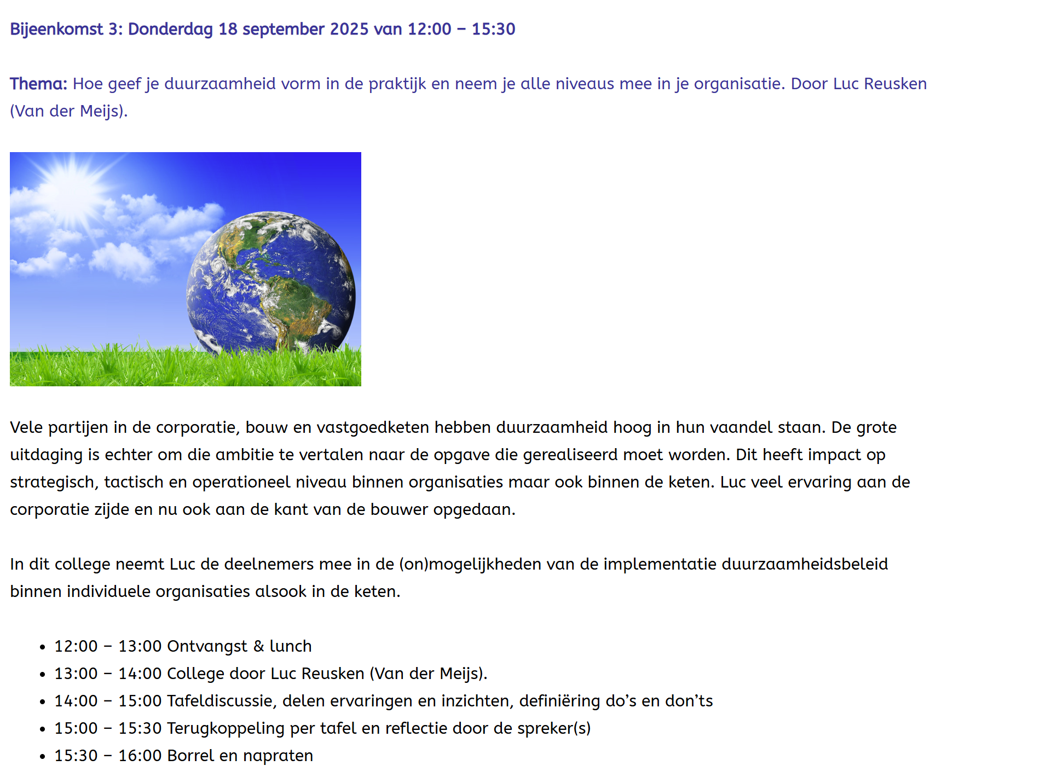
HIGH POTENTIAL PROGRAMMA 2025

Slide 4
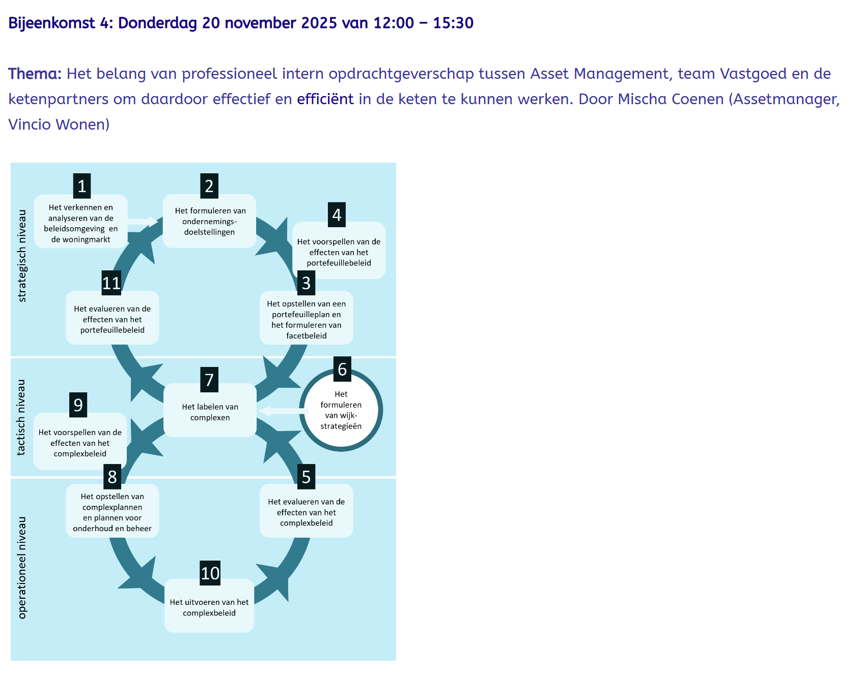
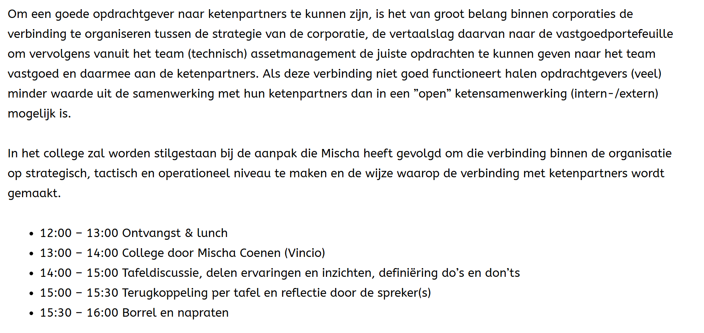
HIGH POTENTIAL PROGRAMMA 2025

Slide 5


HIGH POTENTIAL PROGRAMMA 2025

